Slide 1
MD RoboticS 2016
Control System Kick Off

Slide 2
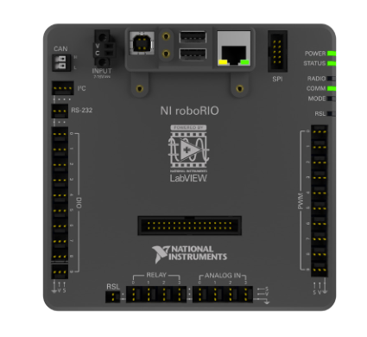
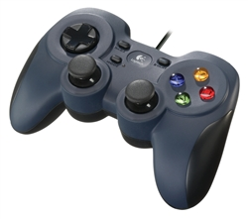
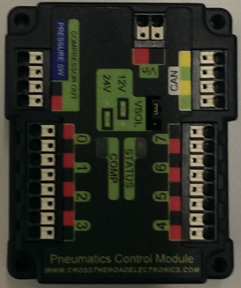
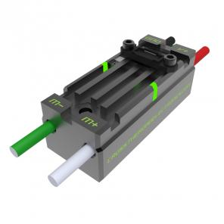
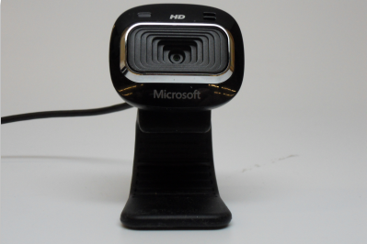
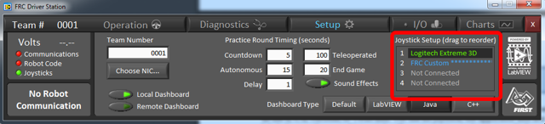
What is the control System?
Documented at https://wpilib.screenstepslive.com/s/4485
Includes:
Roborio / robot code
Driver station
Operator Interface / joystick
Operator console peripherals (hardware & software)
Actuators
Motors
Pneumatics
Telemetry / sensors
Cameras

Slide 3
2015 Accomplishments
1st season with RoboRio & Java
Successfully implemented Java based Command Robot
Successfully implemented complex command sequence
Successfully implemented some sensors
Encoder & optical limiting switches
Successfully implemented control of motors and pneumatics
Successfully implemented gamebox style joystick interface with custom command support
Successfully implemented Mecanum wheel drive system

Slide 4
2015 Challenges
Limited opportunity to practice with fully integrated robot
Simple robot – limited capabilities
Some features not reliable
lift had to be manually controlled in teleop
Depth sensor not consistent
Did not leverage advanced features
No robot vision for targeting or feedback
No gyroscope enabled navigation
No enhanced drive station
No on board co-processors for augmented computing
Limited both autonomous period and teleop period effectiveness and capabilities
Slower than top rated teams at most tasks
Not as reliable as top rated teams

Slide 5



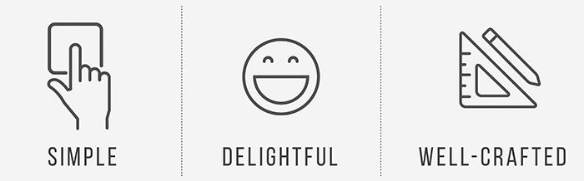
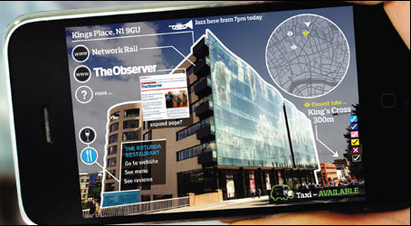
2016 Opportunities
Embedded Computing
UX / Human Interface
Robot Vision
Autonomous operation
Robot logic
Telemetry
PID controllers
Talon SRX
State machines
Complex commands
Multi-threaded concurrent operations
Scheduler
Robot configuration
Improved driving control
Adapt tote driving system
Gyroscope and accelerometer enhanced navigation
Simulation environment
Enable faster development
Version control
Reuse of components from prior years
Enhanced Driver station
More useful robot to driver feedback
Visualization through HTML5/Angular/JavaScript
Adaptive console
Support for more complex interface controls
Improved robot configuration
Real-time robot communications via Websockets
Video Streaming
Compressed video streaming compatible with 7mbps bandwidth limitation
Video / Image processing
Pattern recognition
Augmented Reality
Target acquisition & tracking
Goal
boulder
Score confirmation
Navigational assistance
Autonomous mode assistance
Embedded co-processors

Slide 6

Next Steps
Set up 3 tiger lion teams
Embedded Computing
UX / Human Interface
Robot Vision
At least 2 per team
No prior experience necessary
Get engaged
Establish goals for 2016
Practice
Prototype canon
Prototype scaling mechanism
Build robot
Build obstacles
Participate in local prep scrimmages: e.g. with FriarBots and OC Robotic Alliance
Build up MD Robotics program
Document procedures & tip sheets for future season
Publish work to FRC community for gracious co-opetion award opportunities
Need more mentor help
Recruit
No prior experience necessary

Slide 7

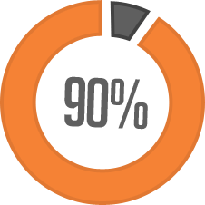
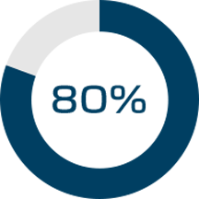
Obstacle Building update
4 obstacles
Cheval de Frise
Moat
Rock Wall
Low bar
Platform
Modular
Convertible to several obstacles
Group A
Group B
Group C
Group D
Low Bar
Portcullis
Cheval de Frise
Moat
Ramparts
Scaling wall
Grab bar
Drawbridge
Sally port
Scaling wall
Rock wall
Rough Terrain

